Slide 1

Charging Habits of Electric Vehicle Customers
By Nicholas Schettini
Notes:
To change the image on this slide, select the picture and delete it. Then click the Pictures icon in the placeholder to insert your own image.

Slide 2
Background
Electric Vehicles are becoming more popular for consumers, especially within large cities like New York.
Benefits:
Reduces carbon footprint of consumer
Helps save consumer money
However, with the increase in electric vehicles, companies that supply electricity to these vehicles are facing new challenges.
Notes:
Electric Vehicles are becoming more and more popular, especially in cities like New York. Consumers are beginning to see the benefit of owning an electric vehicle vs. owning a traditional gasoline powered vehicle.
Such as: helping them to reduce their overall carbon footprint – since there are ~75% less carbon emissions being released from the vehicle, their overall carbon footprint throughout the day is reduced. This is especially important to those consumers who are concerned about the environment.
Electric vehicles also help the consumer save money – they don’t require oil changes, and have less moving parts, meaning: reducing much of the cost of maintenance and no longer must worry about rising gas prices.
However, an electric vehicle doesn’t come with it’s own set of challenges – such as worrying about the car battery giving out, how long it takes to charge the battery, and of course electric prices to actually charge the vehicle.
Which leads to our next part – companies that supply the energy, such as Con Edison now must also face new challenges with being able to reliably provide energy for their electric vehicle customers, and for everyone else.
Understanding when electric vehicle owners are charging, and understanding how much power their using is fundamental to continue supplying reliable energy.

Slide 3

Background
To insure reliable energy supply, we must understand when and how much these vehicles are being charged.

Slide 4
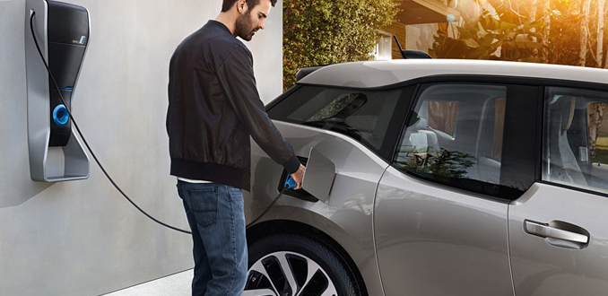
Why Changing Electric Vehicle Customer Charging Habits Matters
A typical daily commute consumes almost as much energy as a small home.
Power transformers, which connect homes and businesses to the grid at a local level, are only able to handle within a certain threshold.
If multiple EVs are charging at the same time on the same local transformer, this could cause potential problems with overloading and potential outages during peak hours.
Source: Fleetcarma
Notes:
According to fleetcarma, a typical electric vehicle consumes about 6-8 kilowatt hours of energy for around a 25 mile commute which is beginning to approach the levels of a small house.
Power transformers, which supply the power to homes, are designed to handle within a certain threshold - in the future, when there are multiple electric vehicles in a neighborhood, the chances of them charging at the same time begin to increase – which can begin to cause other problems with supplying reliable energy to consumers.
One solution is to have customers charge their vehicles during off-peak hours, when there is less load on the electric grid. According to the Con Edison website, off-peak is defined between 12am until 8am.

Slide 5
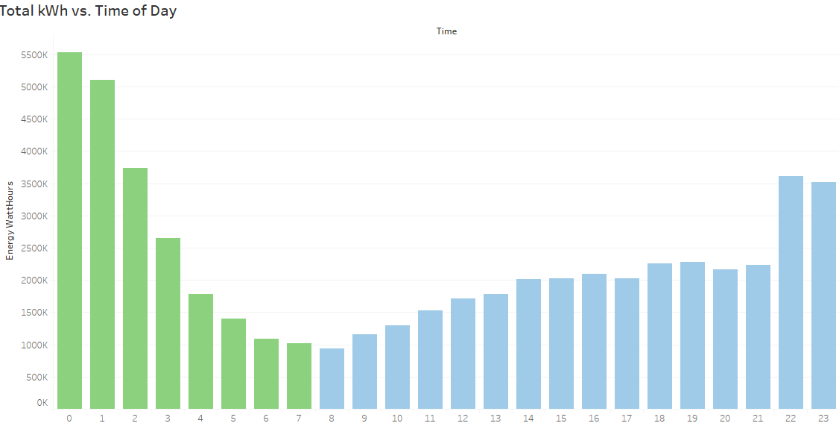

Peak vs off-peak, summer 2015
The risk of overloading is greater during peak hours – when consumers are arriving home.
One solution is to have EV owners charge their vehicles during off-peak times.
~41%
~59%
Off-peak
Peak
Hours of day
Notes:
The risk of overloading is greater during peak hours – when consumers are arriving home, turning on their A/C, washing clothes, etc. In the summer months of 2015, the majority of customers are charging during peak hours. This, as I mentioned earlier, can be a potential problem when more consumers begin adopting electric vehicles.

Slide 6
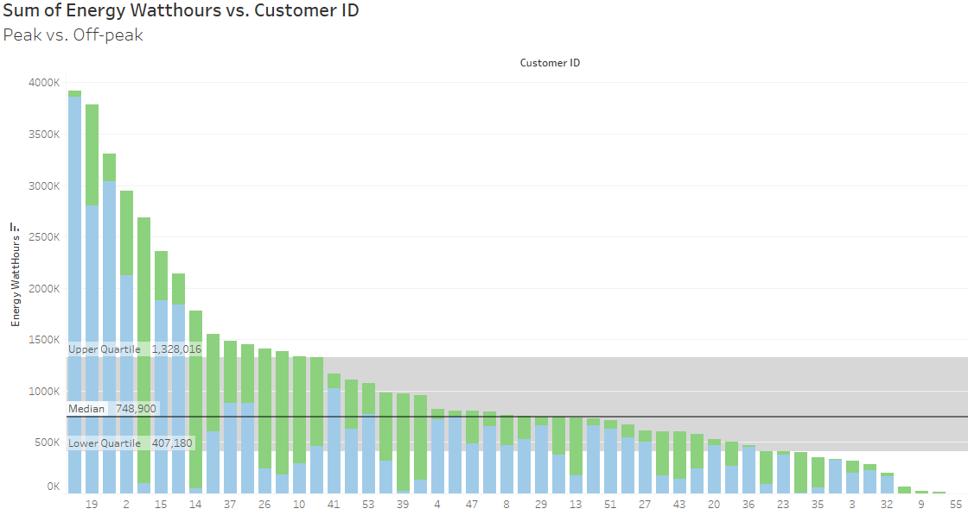
Energy Consumption for a sample of EV Customers
Off-peak
Peak
Notes:
Something that can be done is to look at the customers themselves and look at their charging habits. This graph shows the data similar to the previous, by off-peak and peak, but by the individual customers. In this case, since there are only 56 customers in the data, it’s easier to look at all of the customers. Since we’re focusing on customers that charge during peak hours, we can filter by only that.

Slide 7
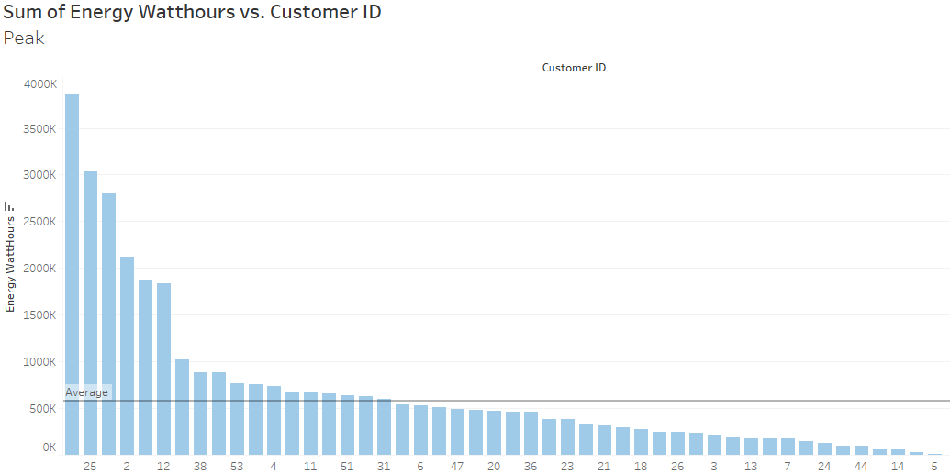
Energy Consumption for a sample of EV Customers
Peak
Notes:
So now that the data is filtered by only peak hours, it makes it easier to look deeper at the charging habits of those that charge during peak hours.

Slide 8
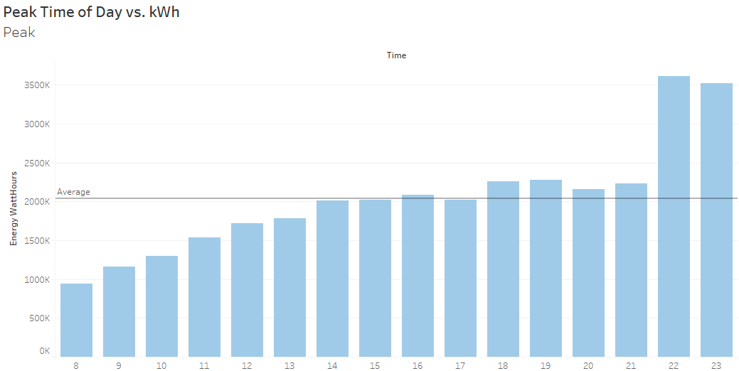
Peak hours vs. time of day
Charging beings to increase around 2:00pm, when customers start arriving home.
Peak
Notes:
So there are a few things we can do now that we have our peak customers. One is to take a look at exactly when throughout the day they’re charging. It seems as if charging beings to increase around 8am, and begins to average out around 2 to around 9, before it increases again, right before the off-peak hours begin.
So, looking at individual customers can be a challenge, especially with the number of vehicles increasing, and you’re looking at thousands of different people. However, customers can be broken down into groups, such as those that charge during super-peak hours or those that consume more than average.

Slide 9

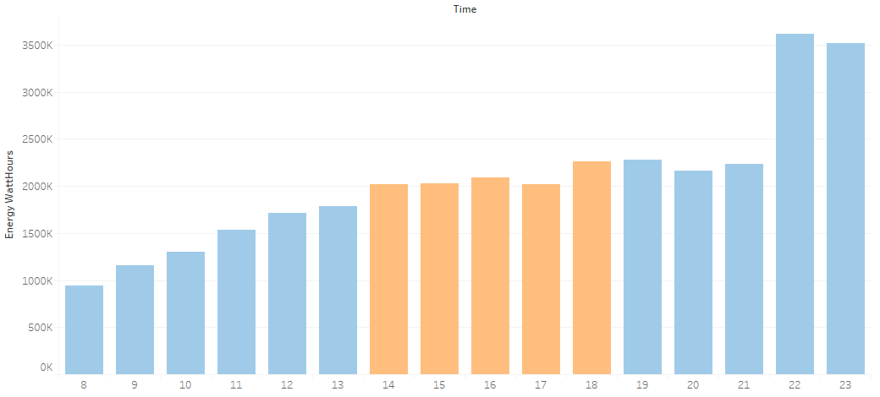
Charging Habits for Super-peak hours
Super-peak hours are from 2-6pm on Weekdays.
~38% of Peak hours are during Super-peak hours.
Super-peak
Notes:
One thing that’s interesting is that in the summer months, there is something called “super peak” hours, that happens between 2 and 6pm – when the energy demand is at its highest. These hours can potential cause the most issues with overloading. These customers could then be targeted for marketing better charging habits

Slide 10
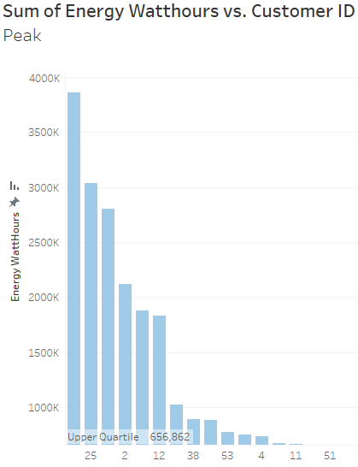
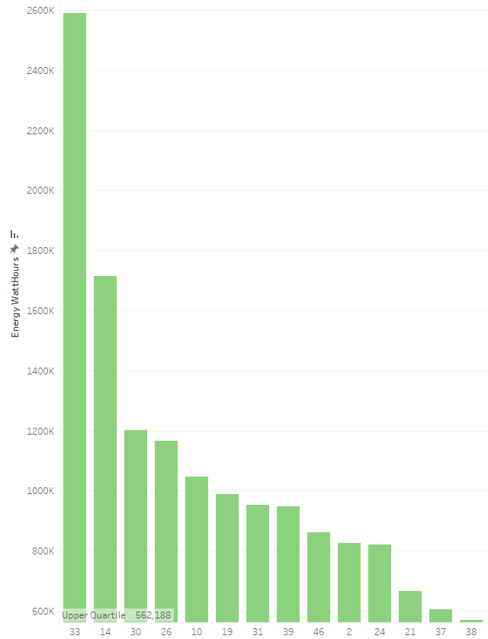
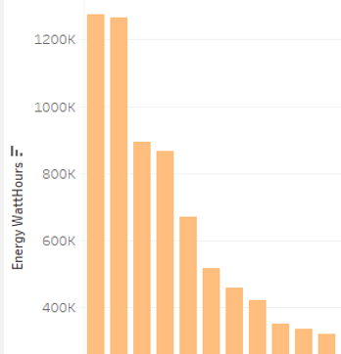
High Energy Customers
Peak
Super-peak
Off-peak
Notes:
Customers can also be targeted that have the highest energy usage during peak hours.

Slide 11
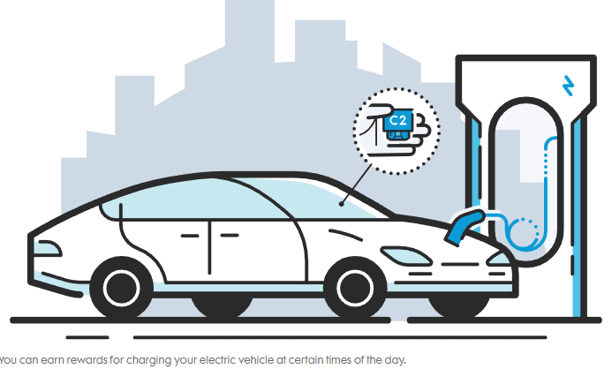
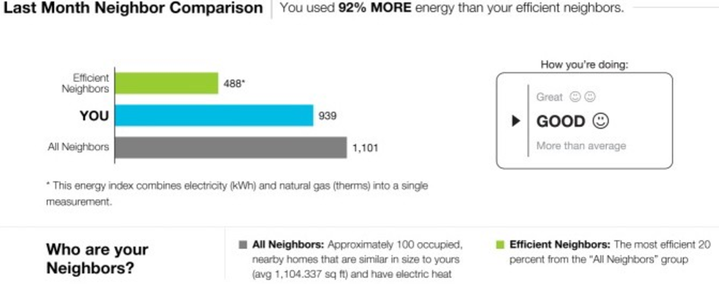
How can customers be encouraged to charge off-peak?
Data! Con Edison's Analytics Website
Email and regular mail
Smart Charge Fleetcarma C2
Money saving incentives
Off-peak pricing! (~21c/kWh vs. 1.54c/kWh)
Notes:
How can customers be encouraged to charge off-peak? Data! Con Edison’s analytic website allows customers to view their electric habits, their bill, and if they’re being efficient. These reports can be mailed and emailed to consumers to alert them if they could be saving money. Fleetcarma’s C2 device allows consumers to see detailed charging data – where they charged, how much energy was used and how long they charged for. Customers can also save money for charging during off-peak hours.

Slide 12
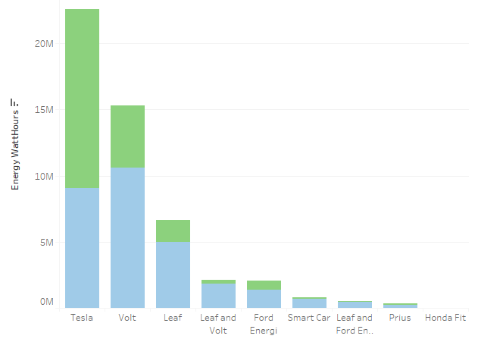
Partnerships with dealers
Dealerships can work with customers to program charging schedules
Smart Charge Program
Perks for sales consultants and managers
Consumer benefits
Fleetcarma C2 device
Charging location, time, energy consumption
Notes:
How can customers be encouraged to charge during off-peak hours?
Working with dealerships. Sales consultants from the dealerships are the first to come in contact with the customer. Consultants can work with customers on setting up charging schedules and educating on the cost saving benefits of off-peak vs peak. Dealerships can also promote the fleetcarma C2 device, which is partnered with con Edison, which helps gather charging specific data for the customer to evaluate.

Slide 13
Summary and further investigations
Here’s where the problem is … majority of charging happens during peak hours (59% vs. 41%). 38% of peak are during super-peak hours
Here’s what it costs … reliability, cost (for consumer and Con Ed)
Further investigations
Customer demographics – age, location
Type of charging station used – level ½
Location of charging (home, work, etc.)
Miles driven per day
Comparison from 2015 – 2018

Slide 14
Thank you
References :
https://www.fleetcarma.com/impact-growing-electric-vehicle-adoption-electric-utility-grids/
https://www.coned.com/en/save-money/energy-saving-programs/time-of-use
https://www.coned.com/en/save-money/rebates-incentives-tax-credits/rebates-incentives-tax-credits-for-residential-customers/electric-vehicle-rewards
http://rpubs.com/nschettini/408284

